Slide 1
SECOND: Sparsely Embedded Convolutional Detection
Yan. Y, Mao. Y, Li. B, “SECOND: Sparsely Embedded Convolutional Detection,” Sensors, 18-10, 3337, Oct 2018.

Slide 2
Outline
Introduction
Related Work
SECOND Detector
Network Architecture
Loss
Data Augmentation
Experiments
Conclusion

Slide 3
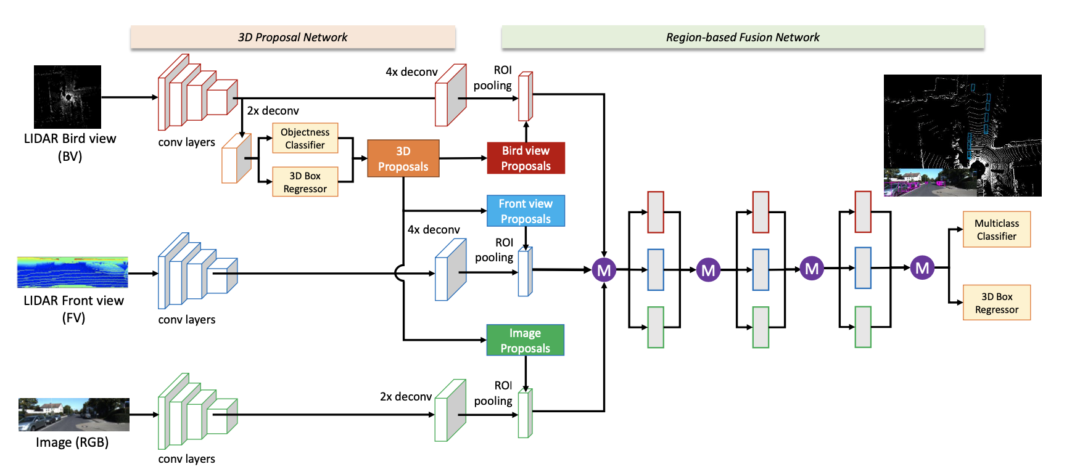
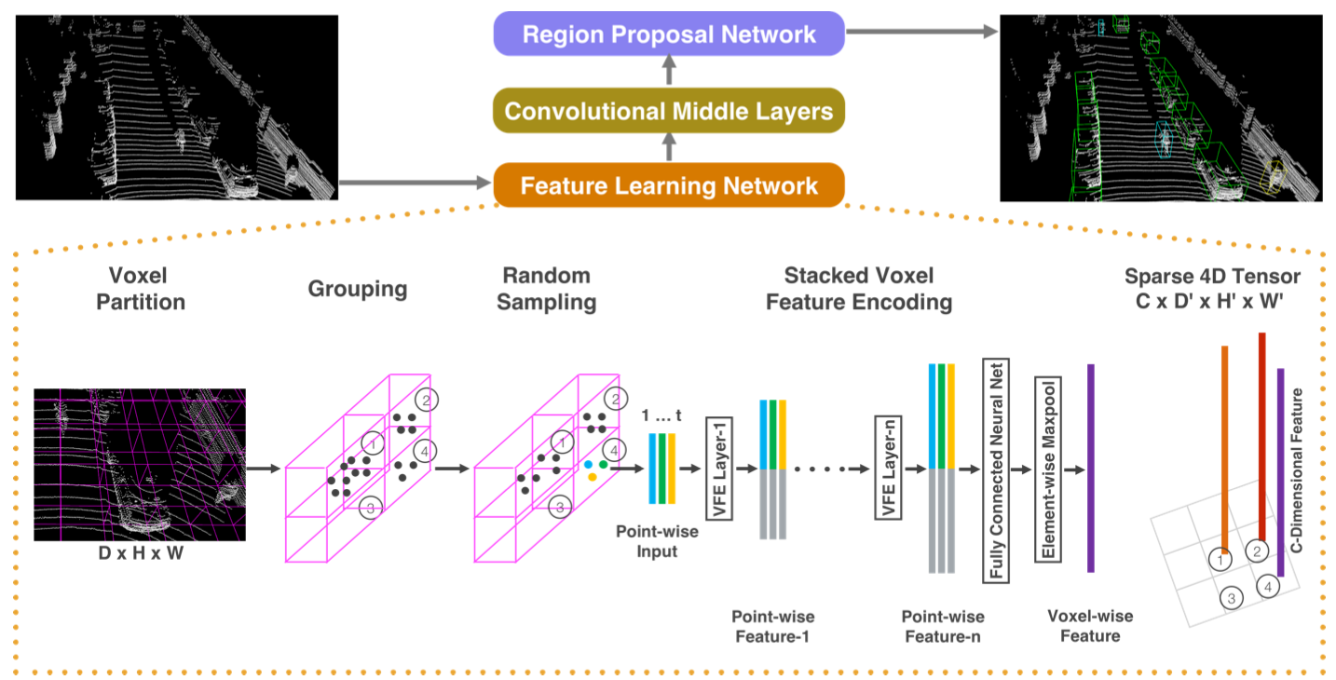
Introduction (1 / 2)
Current 3D object detection Methods
A fusion method that exploits both images and point cloud data : MV3D
The point cloud data are assigned to volumetric grid cells via quantization (Voxel), and 3D CNNs are then applied : VoxelNet
However, its computational cost makes it difficult to use for real-time applications
Plus, VoxelNet‘s orientation performance is low
<MV3D>
<VoxelNet>

Slide 4
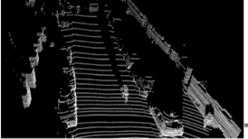
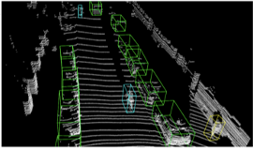
Introduction (2 / 2)
Contribution
Apply sparse convolution in LiDAR-based object detection, thereby greatly increasing the speeds of training and inference
Propose a novel angle loss regression approach that demonstrates better orientation regression performance
Introduce a novel data augmentation method for LiDAR-only learning problems that greatly increases the convergence speed and performance
Feature Learning Network
Convolutional Middle Layers
Region Proposal Network (RPN)

Slide 5
Related Work
Front-View and Image-Based Methods
Hand-crafted feature maps, CNN
Poor performance for both BEV detection and 3D detection compared to other methods
Bird’s-Eyes-View-Based Methods
ComplexYOLO, (MV3D)
Many data points are dropped when generating a BEV map, resulting in a considerable loss of information on the vertical axis
3D-Based Methods
Vote3deep, VoxelNet
The high computational cost of 3D CNNs
Fusion-Based Methods
Point Cloud + RGB -> MV3D / 2D CNN + PointNet
Restricted the environments in which such methods can be used

Slide 6
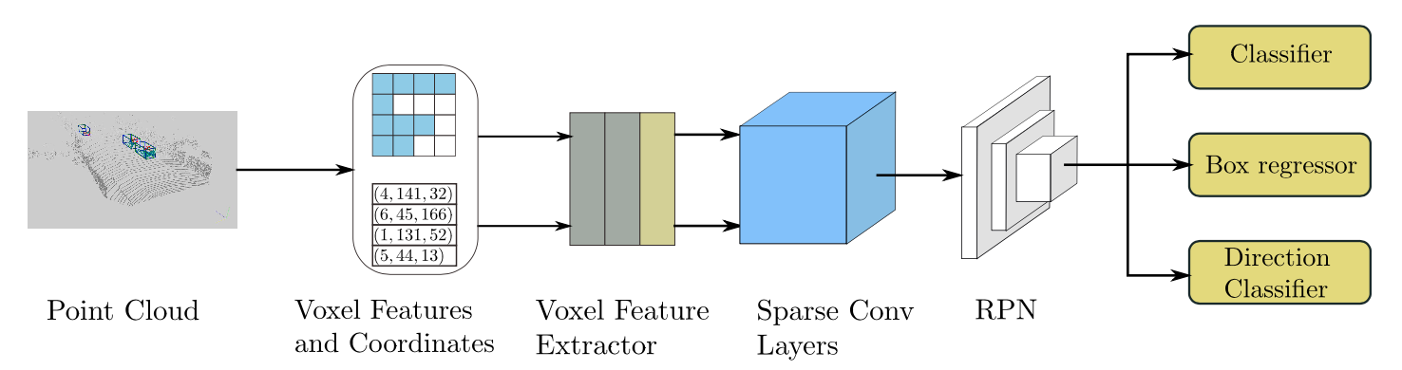
SECOND Detector (1 / 14)
Network Architecture
1
2
3
3 Components
Voxel-wise Feature Extractor
Sparse convolutional middle layers
RPN

Slide 7
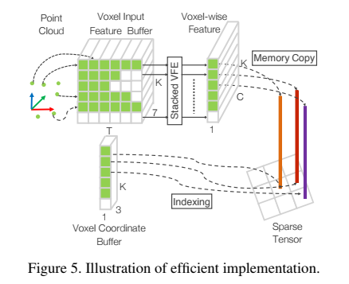
SECOND Detector (2 / 14)
Point Cloud Grouping
Similar procedure to VoxelNet^{[1]}
Preallocate buffers based on the specified limit on the number of voxels
Iterate over the point cloud, assign the points to their associated voxels and save the voxel coordinates and the number of points per voxel
Check the existence of the voxels based on a hash table
Not exist in table, Set the corresponding value
Otherwise, Increment the number of voxels by one
Stop once the number of voxels reaches the specified limit
Obtain all voxels, their coordinates and the number of points per voxel for the actual number of voxels
[1] Zhou. Y, Tuzel. O, “VoxelNet: End-to-End Learning for Point Cloud Based 3D Object Detection,” arXiv:1711.06396.

Slide 8
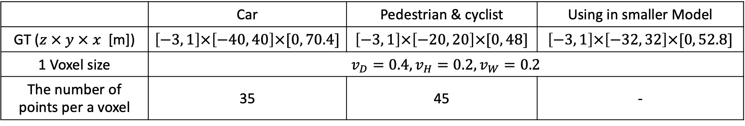
SECOND Detector (3 / 14)
Point Cloud Grouping
In KITTI dataset,
 | Car | Pedestrian & cyclist | Using in smaller Model
GT ($z × y × x$ [m]) | $$\left[−3, 1\right]×\left[−40, 40\right]×[0, 70.4]$$ | $$\left[−3, 1\right]×\left[−20, 20\right]×[0, 48]$$ | $$\left[−3, 1\right]×\left[−32, 32\right]×[0, 52.8]$$
1 Voxel size | $$v_{D}=0.4, v_{H}=0.2, v_{W}=0.2$$
The number of points per a voxel | 35 | 45 | -
⇒ Pedestrians and cyclists are smaller, and more points are needed for voxel-wise feature extraction

Slide 9
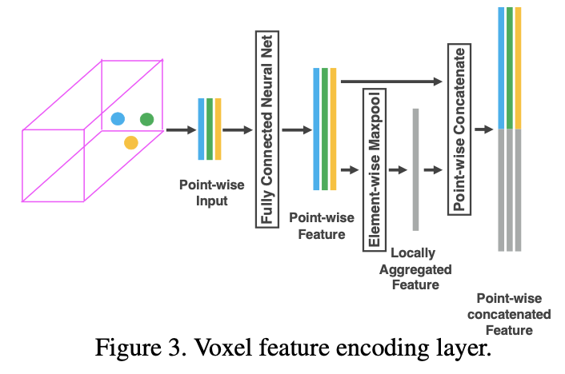
SECOND Detector (4 / 14)
Voxel-wise Feature Extractor
Similar procedure to VoxelNet^{[1]}
Use a voxel feature encoding (VFE) layer
Take all points in the same voxel as input
Use a fully connected network (FCN = Linear layer + BN layer + ReLU layer) to extract pointwise features
Use element-wise max pooling to obtain the locally aggregated features for each voxel
Concatenate the locally aggregated features and the point-wise features
[1] Zhou. Y, Tuzel. O, “VoxelNet: End-to-End Learning for Point Cloud Based 3D Object Detection,” arXiv:1711.06396.

Slide 10
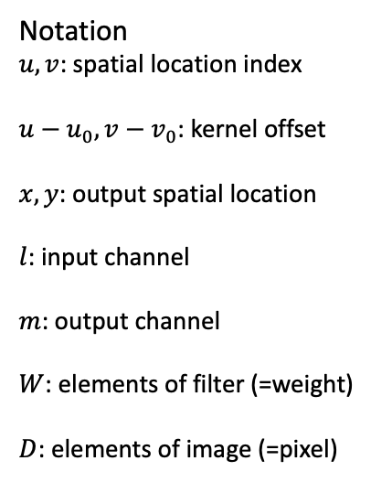
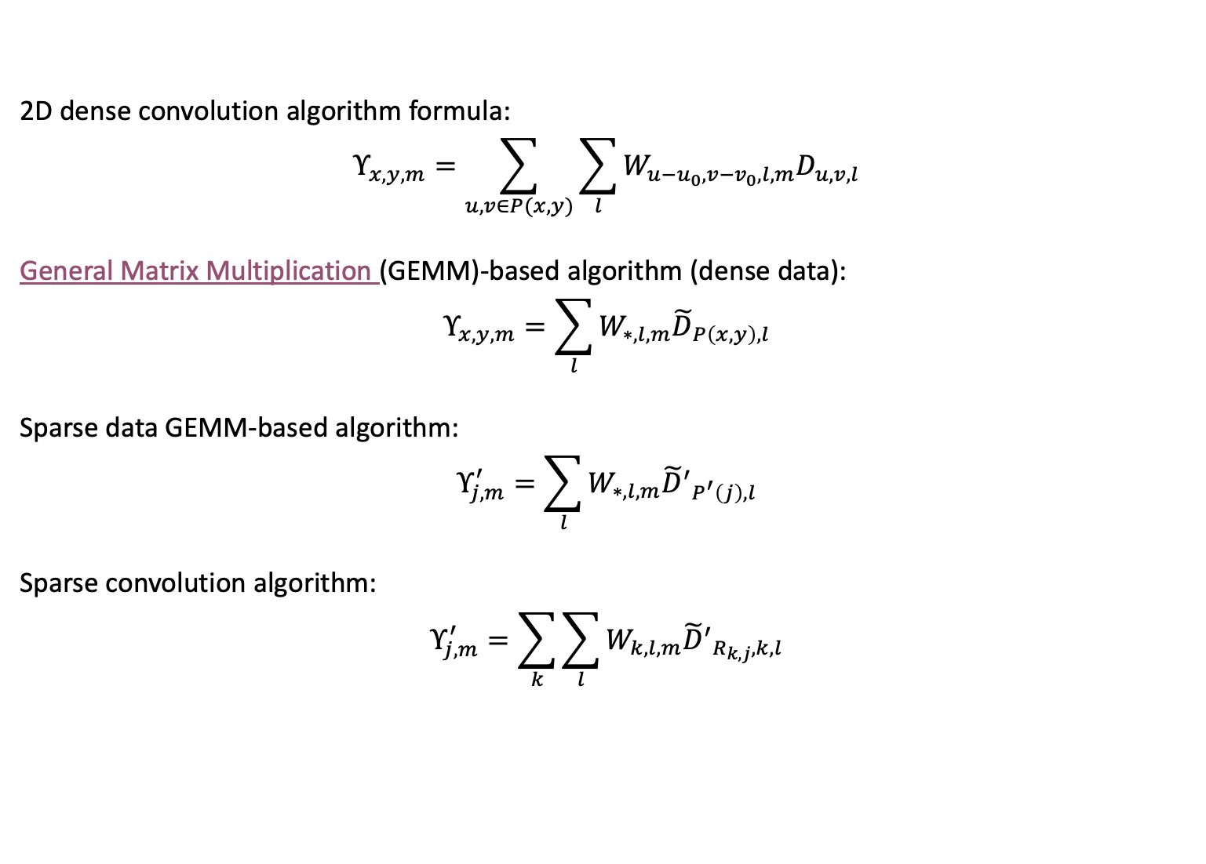
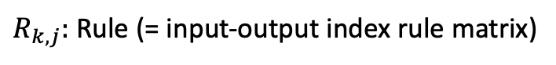
SECOND Detector (5 / 14)
Sparse Convolutional Algorithm
2D dense convolution algorithm formula:
$$Υ_{x,y,m}=\sum_{u,v∈P(x,y)}{\sum_{l}{W_{u−u_{0},v−v_{0},l,m}D_{u,v,l}}}$$
General Matrix Multiplication (GEMM)-based algorithm (dense data):
$$Υ_{x,y,m}=\sum_{l}{W_{∗,l,m}{\tilde{D}}_{P\left(x,y\right),l}}$$
Sparse data GEMM-based algorithm:
$$Υ_{j,m}^{′}=\sum_{l}{W_{∗,l,m}{{\tilde{D}}^{′}}_{P^{′}\left(j\right),l}}$$
Sparse convolution algorithm:
$$Υ_{j,m}^{′}=\sum_{k}{\sum_{l}{W_{k,l,m}{{\tilde{D}}^{′}}_{R_{k,j},k,l}}}$$
Notation
$u,v$: spatial location index
$u−u_{0},v−v_{0}$: kernel offset
$x,y$: output spatial location
$l$: input channel
$m$: output channel
$W$: elements of filter (=weight)
$D$: elements of image (=pixel)
$R_{k,j}:$ Rule (= input-output index rule matrix)

Slide 11
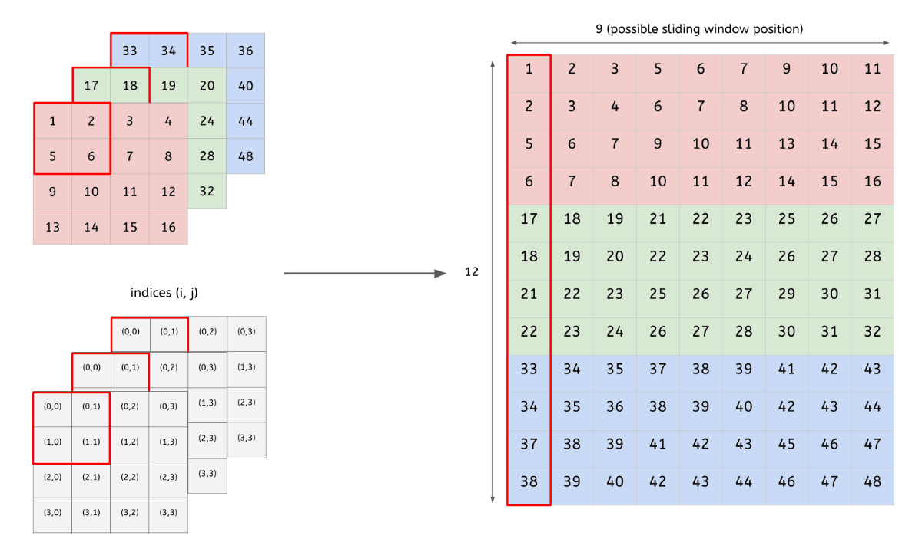
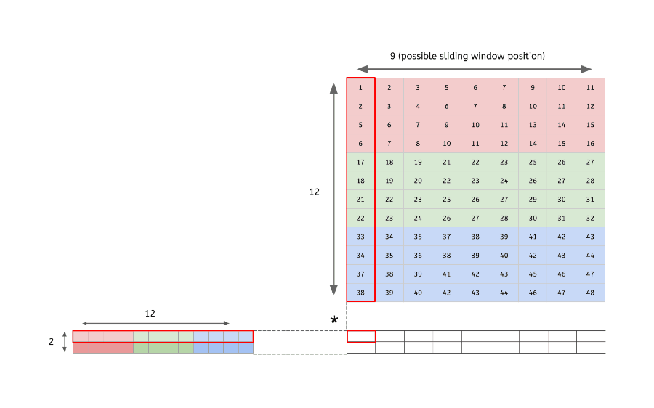
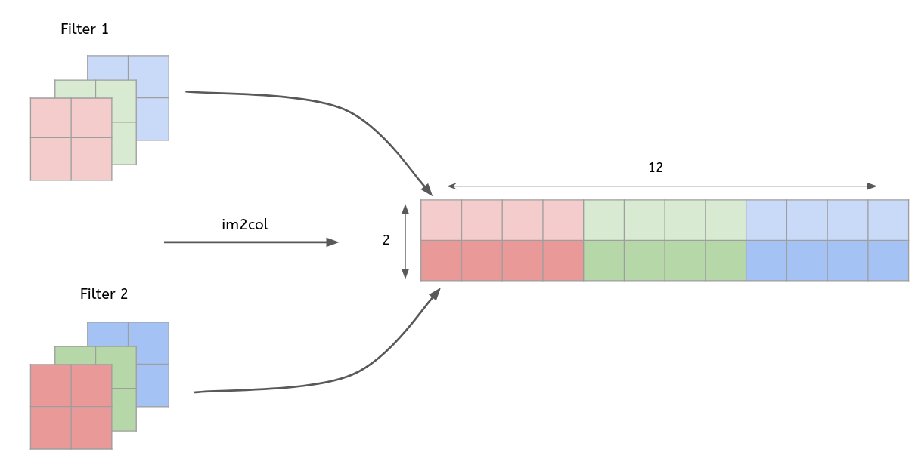
GEMM (im2col)
STEP #1. Transform our input image into a matrix
STEP #3. Matrix multiplication
STEP #2. Reshape kernel (flatten)
STEP #4. Reshape image (col2im)

Slide 12
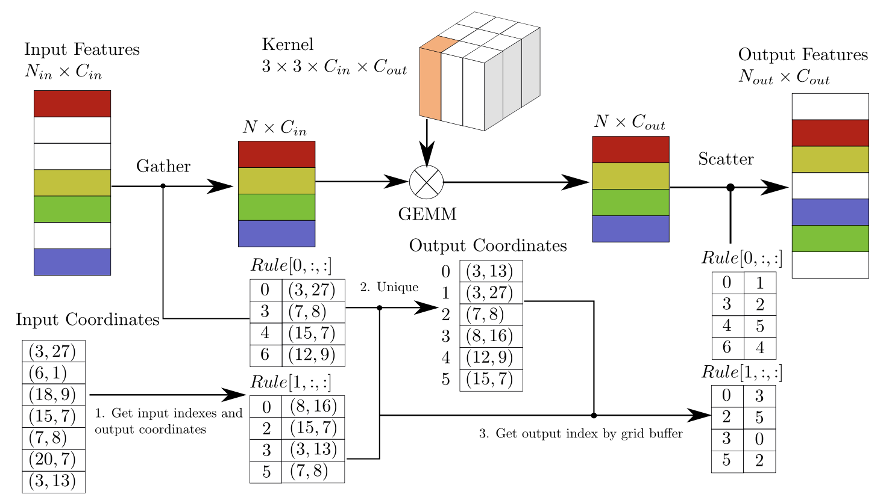
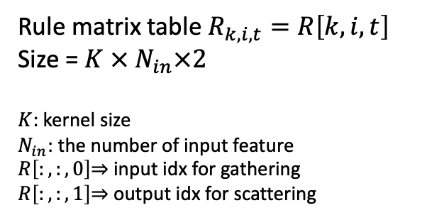
SECOND Detector (6 / 14)
Sparse Convolutional Algorithm
Rule matrix table $R_{k,i,t}=R\left[k,i,t\right]$
Size = $K × N_{in}×2$
$K$: kernel size
$N_{in}$: the number of input feature
$R\left[:,:,0\right]$⇒ input idx for gathering
$R\left[:,:,1\right]$⇒ output idx for scattering

Slide 13
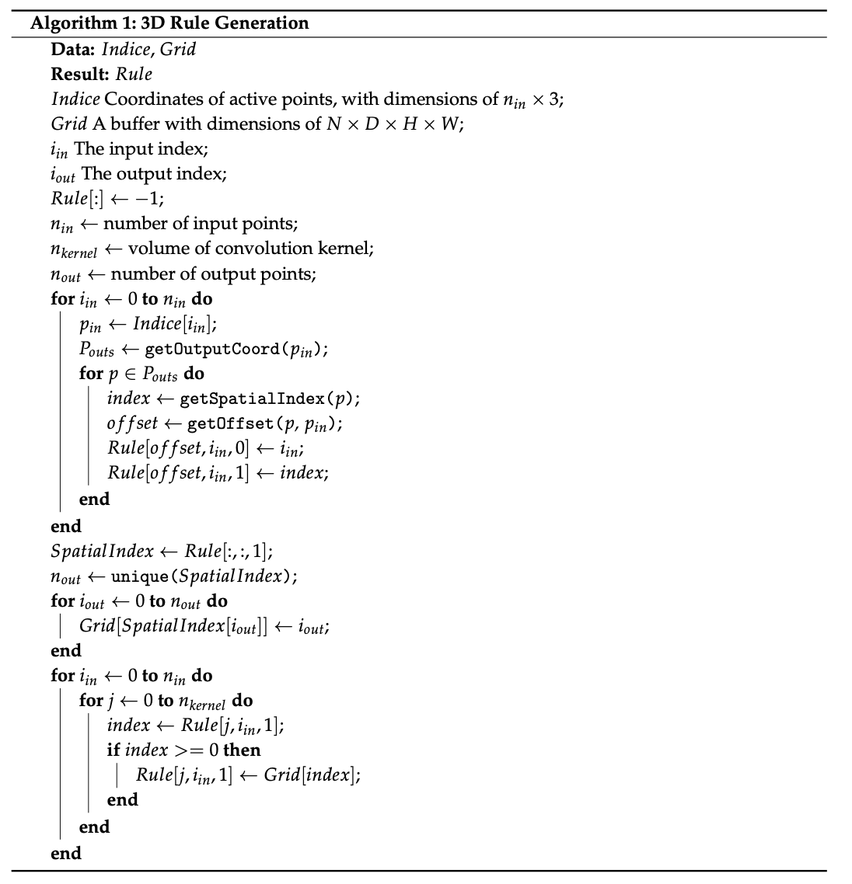
SECOND Detector (7 / 14)
Rule Generations Algorithm
input point들을 반복하면서 각각의 input point와 관련된 output을 찾아 rule에 저장하는 방법으로 진행됨.
총 3번의 Loop로 구성이 됨.
Loop 1.
input index와 associated spatial index를 수집함.
associated spatial index를 수집하는 이유는 Rule의 압축 규칙에서 저장된 입력 데이터의 인덱스들을 활용하여 출력 데이터의 인덱스를 결정하기 때문에 필요함.
Loop 2.
다음 단계에 쓰일 table lookup을 위해서 이전 결과에서 생성된 sparse data와 동일한 spatial dimension을 가지는 buffer를 생성함.
Loop 3.
마지막으로 rule을 반복하면서 각각의 input index에 해당하는 output index를 얻기 위해 저장된 spatial index를 사용함. -> Rule 압축 규칙

Slide 14
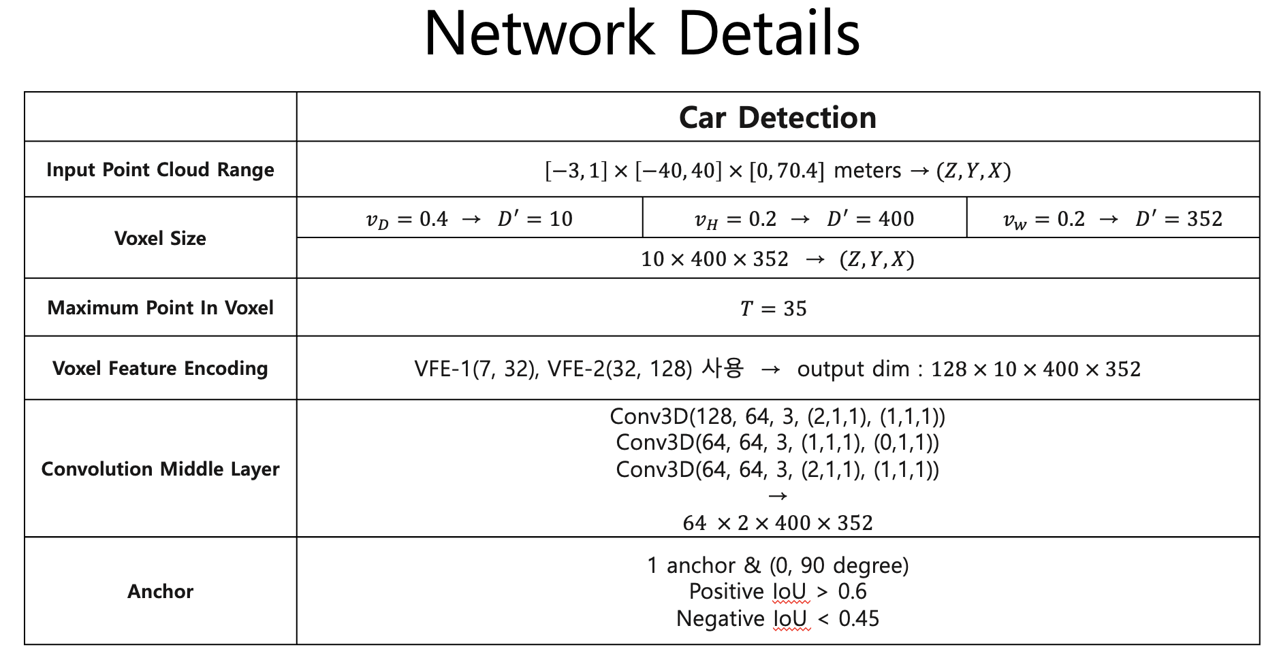
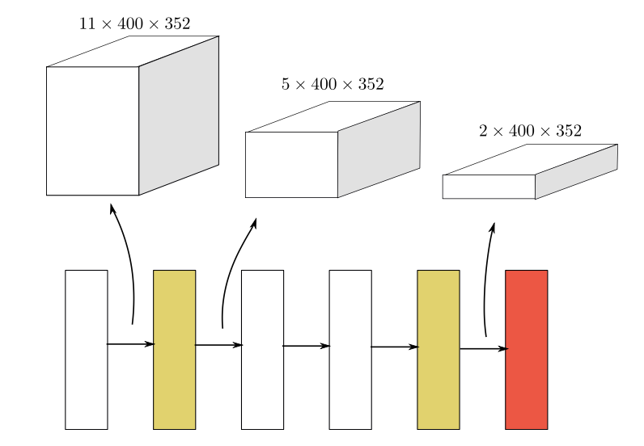
SECOND Detector (8 / 14)
Sparse Convolutional Middle Extractor
Learn information about the z-axis and convert the sparse 3D data into a 2D BEV image
Submanifold convolution
Sparse convolution : downsampling in the z-axis
Kernel size = (3, 1, 1), Stride = (2, 1, 1)
Sparse-to-dense convolution : z dimension is 1 or 2, the sparse data are converted into dense feature maps
Output : 64 X 2 X 400 X 352

Slide 15
Submanifold & Sparse Convolution
P1
F0
F1
F2
P2
F3
F4
F5
F6
F7
F8
Stride = 1, padding = 0
3 X 3, 3 Channel kernel
5 X 5, 3 Channel input

Slide 16
Submanifold & Sparse Convolution
Sparse Convolution output :
일반적인 convolution output과 비슷하다.
Submanifold Convolution output :
커널의 중앙이 input에 존재하는 값을 지날 때 계산된다.
왜 두 종류의 convolution을 사용했냐?
Submanifold convolution만을 사용하면, input 데이터에 대한 spatial한 정보를 손실
Sparse convolution을 동시에 사용해서 spatial한 정보를 보강
A1
A1A2
A1A2
F0
A1
F2
A1
A1A2
A1A2
F3
F4
A2
A2
A2
F6
F7
F8
Sparse Conv. output
Submanifold Conv. output
P1
P2

Slide 17
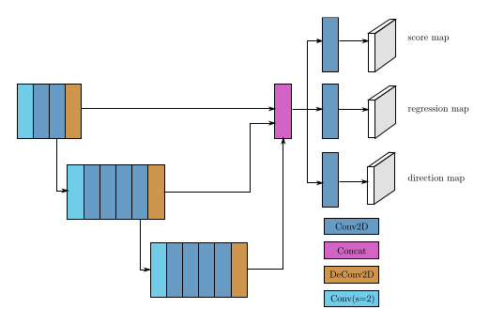
SECOND Detector (9 / 14)
Region Proposal Network
Similar architecture to Single Shot Multibox Detector (SSD)^{[2]}
Input: the feature maps from the sparse convolutional middle extractor
3 Steps
Each stage starts with a convolutional layer for downsampling, goes through several more convolutional layers, and then goes through a BN and ReLU layer
Upsampling the output of each stage to a feature map of the same size and concatenate these feature maps into one feature map
Three 1 × 1 convolutions are applied for the prediction of class, regression offsets and direction
Output: score, regression and direction map
[2] Liu. W, Anguelov. D, Erhan. D, Szegedy. C, Reed. S, Fu. C. Y, and Berg. A. C, “SSD: Single Shot Multibox Detector,” in Proc. European Conference on Computer Vision (ECCV) 2016, p.21-37, Amsterdam, Netherlands, Oct 2016.

Slide 18
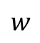
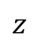
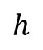
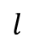
SECOND Detector (10 / 14)
Anchors and Targets
검출되는 물체는 대략적으로 고정된 크기를 가짐
>> KITTI training set에서 0도와 90도 회전된 GT의 중심 위치와 크기의 평균을 기반으로 고정된 크기의 anchor를 사용
Classification : one-hot vector of classification target
Regression : 7-vector box regression target
Direction : one-hot vector of direction classification target
Threshold (IoU) for matching/non-matching
Car : w = 1.6, l = 3.9, h = 1.56, z = -1.0
Pedestrian : w = 0.6, l = 0.8, h = 1.73, z = -0.6
Cyclist : w = 0.6, l = 1.76, h = 1.73, z = -0.6
$$z$$
$$h$$
$$l$$
$$w$$
0.45 (0) < Car < 0.6 (1)
0.35 (0) < Pedestrian, Cyclist < 0.5 (1)

Slide 19
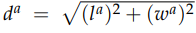
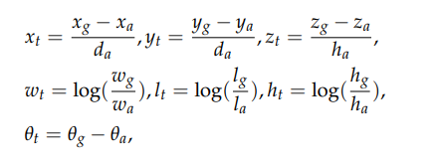
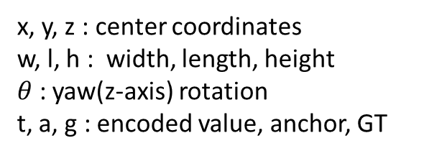
SECOND Detector (11 / 14)
Anchors and Targets
x, y, z : center coordinates
w, l, h : width, length, height
$θ$ : yaw(z-axis) rotation
t, a, g : encoded value, anchor, GT

Slide 20
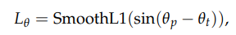
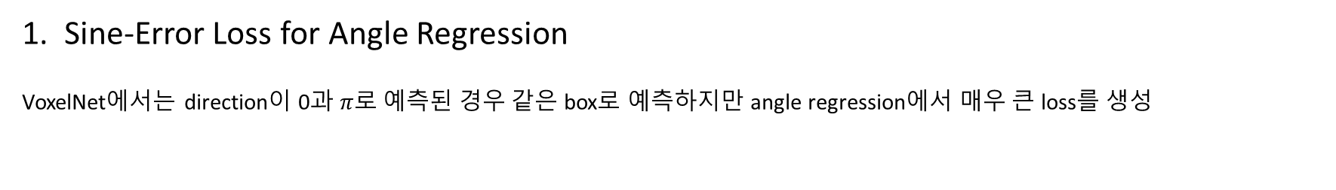
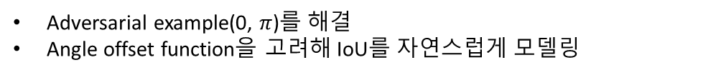
SECOND Detector (12 / 14)
Loss
Sine-Error Loss for Angle Regression
VoxelNet에서는 direction이 0과 $π$로 예측된 경우 같은 box로 예측하지만 angle regression에서 매우 큰 loss를 생성
Adversarial example(0, $π$)를 해결
Angle offset function을 고려해 IoU를 자연스럽게 모델링
반대 방향의 상자를 동일한 것으로 취급하는 문제를 해결하기 위해 RPN의 output에 direction classifier를 추가
-> softmax loss function
Yaw rotation > 0 : positive
Yaw rotation < 0 : negative

Slide 21
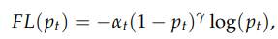
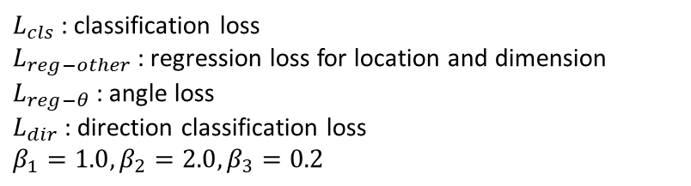
SECOND Detector (13 / 14)
Loss
2. Focal Loss for Classification
Classificaiton은 RetinaNet에서 소개된 Focal Loss를 사용
-> foreground와 background class간의 심각한 class imbalance문제를 해결
$α_{t}$ = 0.25, $γ=2$ in training process
3. Total Training Loss
$L_{cls}$ : classification loss
$L_{reg−other}$ : regression loss for location and dimension
$L_{reg−θ}$ : angle loss
$L_{dir}$ : direction classification loss
$$β_{1}=1.0, β_{2}=2.0, β_{3}=0.2$$

Slide 22
SECOND Detector (14 / 14)
Data Augmentation
Sample Ground Truths from the Database
Training 과정에서 사용되는 GT의 개수가 너무 적어서 수렴속도와 최종성능의 상당한 한계가 생김
먼저, 모든 GT label과 그와 관련된 point cloud data를 담은 database를 생성
이후 학습과정에서 몇 개의 GT를 random하게 골라서 현재 학습중인 point cloud에 concat하여 학습을 진행
Concat한 이후에 추가한 GT가 기존에 존재하던 GT들과 물리적 충돌이 일어날 수 있으므로 충돌 test를 진행한 뒤 만약 기존 GT와 추가한 GT가 충돌한다면 삭제한 뒤 학습을 진행

Slide 23
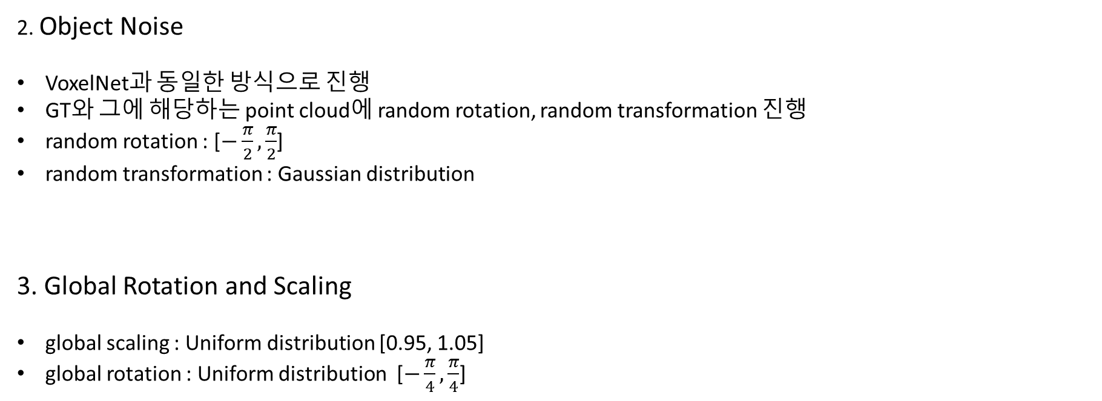
SECOND Detector (14 / 14)
Data Augmentation
2. Object Noise
VoxelNet과 동일한 방식으로 진행
GT와 그에 해당하는 point cloud에 random rotation, random transformation 진행
random rotation : [$−\frac{π}{2},\frac{π}{2}$]
random transformation : Gaussian distribution
3. Global Rotation and Scaling
global scaling : Uniform distribution [0.95, 1.05]
global rotation : Uniform distribution [$−\frac{π}{4},\frac{π}{4}$]

Slide 24
Experiments (1 / 5)
Evaluation Conditions
Train Dataset : KITTI dataset
Train : Val = 1 : 1 (3712 : 3769)
Class : Car, Pedestrian and Cyclist
Level : easy, moderate and hard (⇒ the object height in the 2D results, occlusion and truncation)
Train Optimizer : Adam
Mini-batch : 3 point clouds
Epoch : 160
Initial learning rate : 0.0002
Decay weight : 0.0001

Slide 25
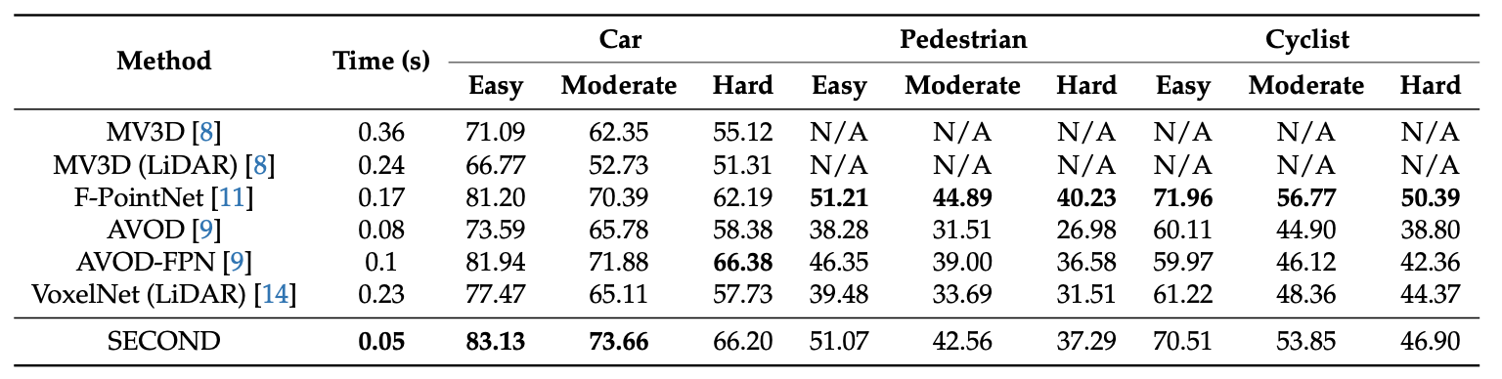
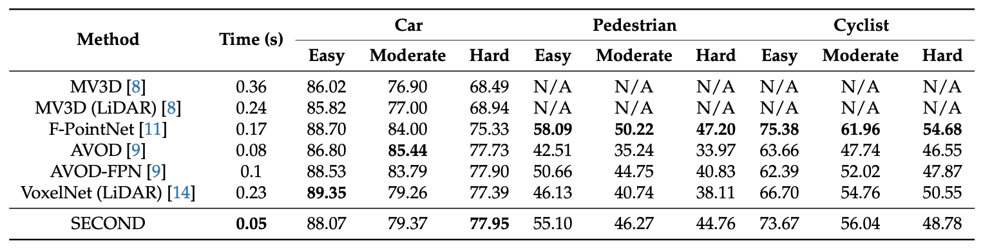
Experiments (2 / 5)
Evaluation Using the KITTI Test Set
SOTA results with only LiDAR data
Lowest time consumption
AVOD-FPN
both image and LiDAR data
85/15 split
ground plane estimation
F-PointNet
Using a 2D detector
3D
detection
BEV
detection

Slide 26
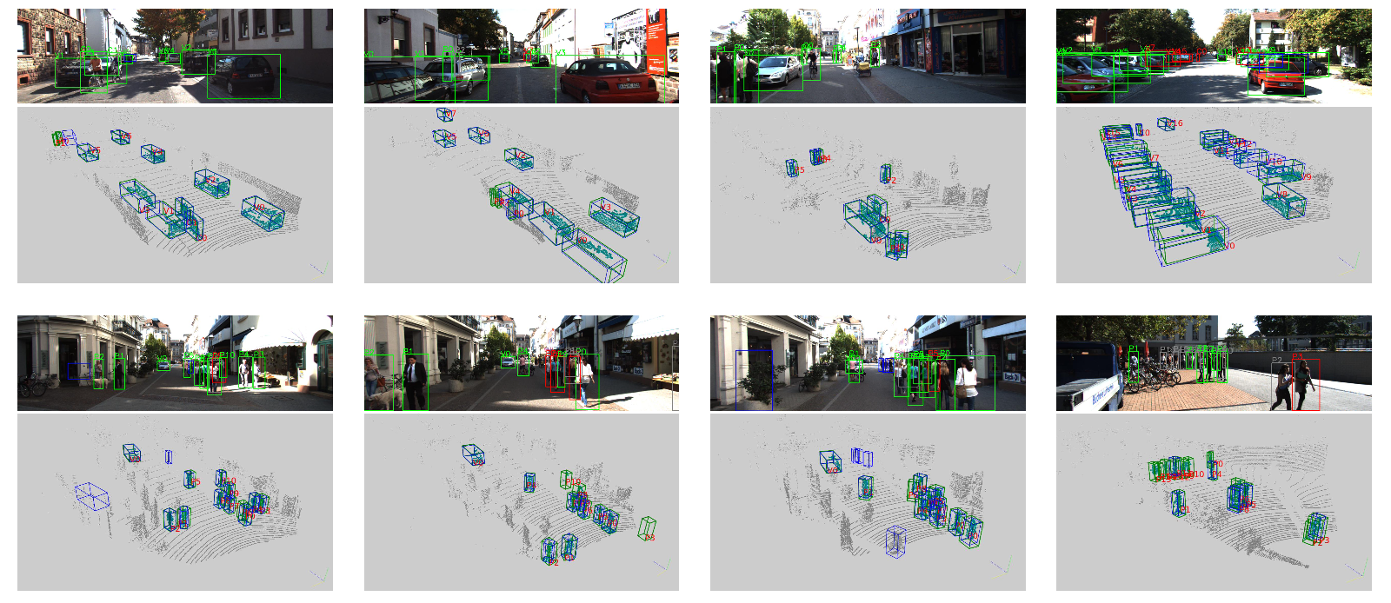
Experiments (3 / 5)
Detection Results (KITTI validation set)
Car detection
Image
“V” = Car
“P” = Pedestrian
“C” = Cyclist
Green box : Successful detection
Blue box : False positive
Red box : Low accuracy
Gray box : False negative
Point Cloud
Green box : GT
Blue box : Detection result
Pedestrian and Cyclist detection

Slide 27
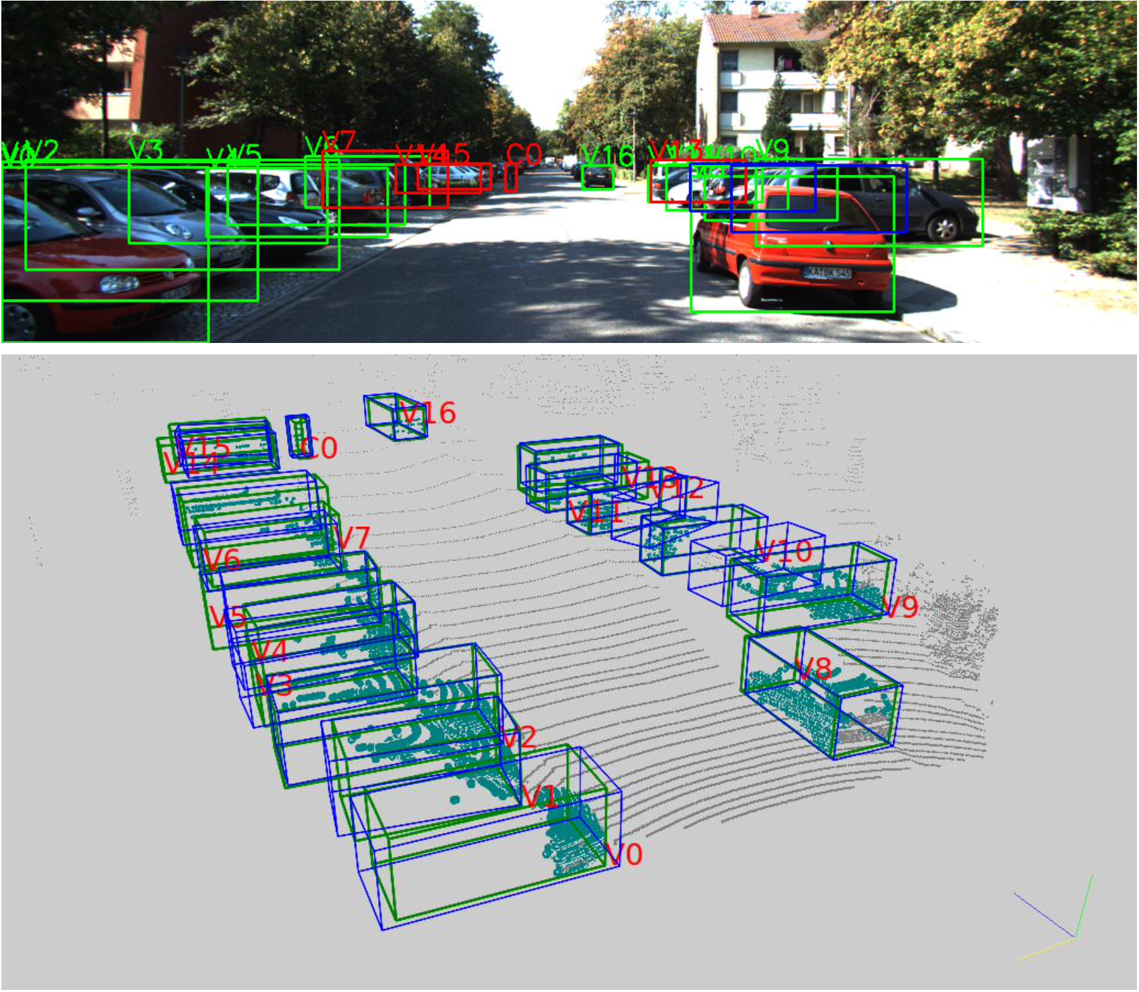
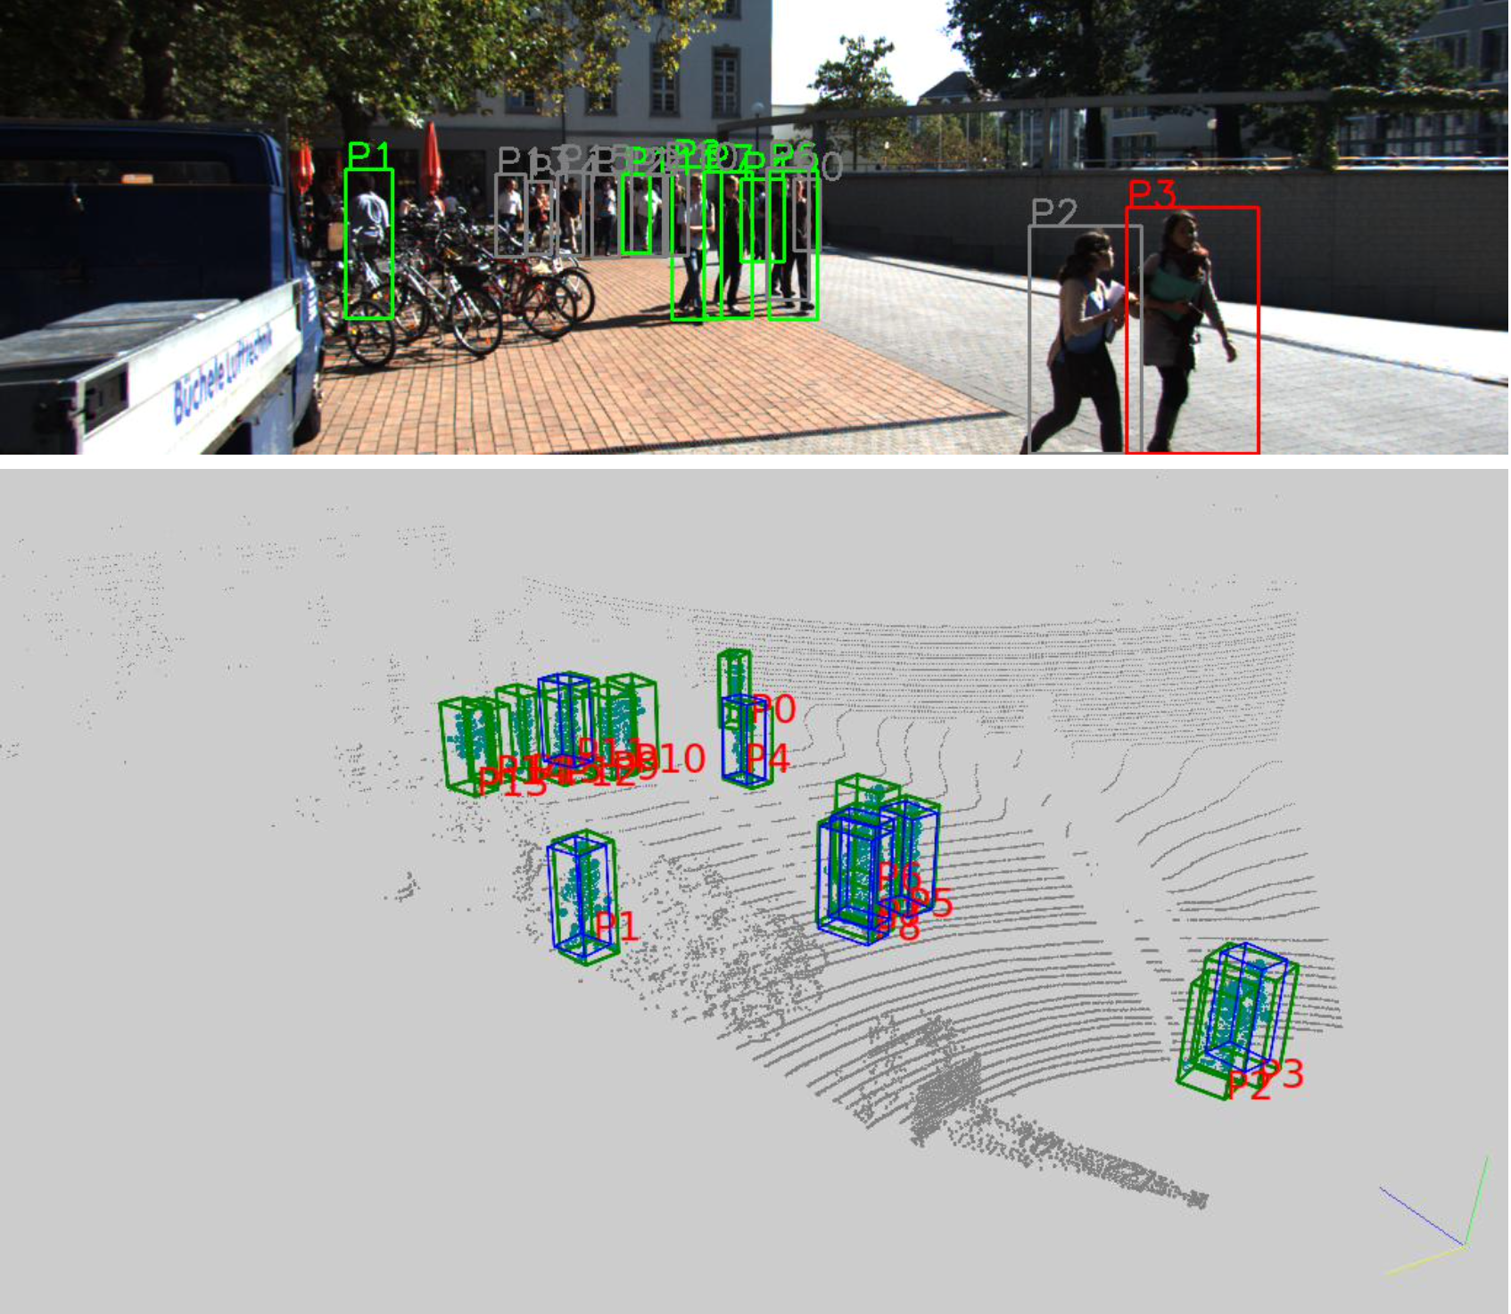
Experiments (4 / 5)
Detection Results (KITTI validation set)
Car detection
Pedestrian and Cyclist detection
Image
“V” = Car
“P” = Pedestrian
“C” = Cyclist
Green box : Successful detection
Blue box : False positive
Red box : Low accuracy
Gray box : False negative
Point Cloud
Green box : GT
Blue box : Detection result

Slide 28
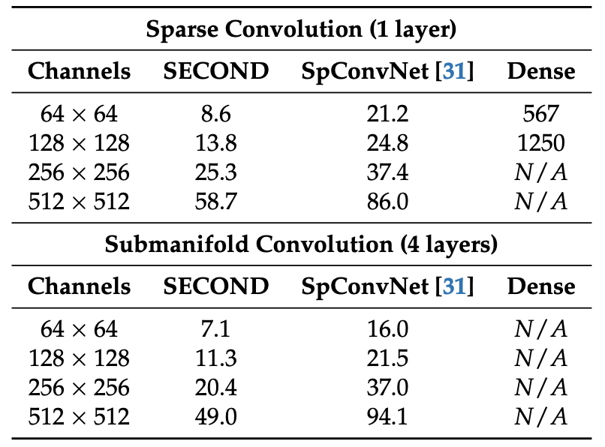
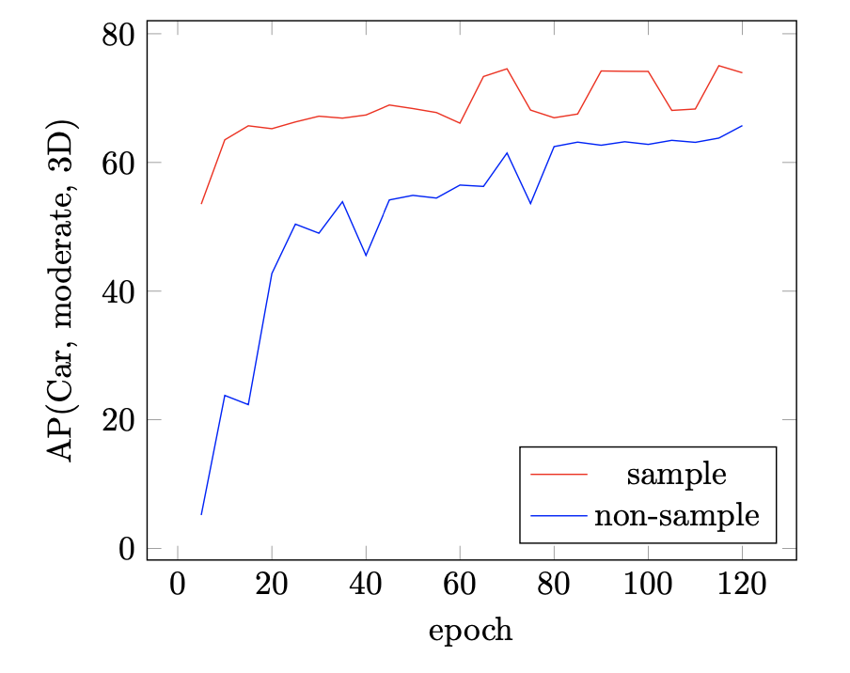
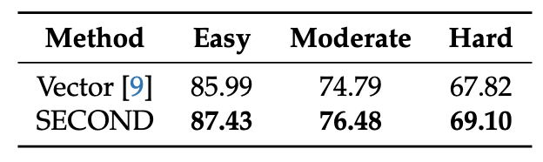
Experiments (5 / 5)
Ablation Study
Sparse Conv Performance
Different Angle Encodings
Sampling GTs
Sparse convolution approach is faster than the SpConvNet because of its faster rule generation
SECOND of handling angles performs better than the angle vector encoding used in AVOD
Sampling approach greatly increases the convergence speed and rectify imbalance between positive and negative

Slide 29
Conclusion
Summary
In this paper, we have introduced a novel method of angle loss regression, have successfully applied sparse convolution in a LiDAR-based network and have proposed a novel approach to data augmentation that makes full use of the advantages of point clouds
Experiments on the KITTI dataset have shown that the proposed network produce SOTA results
Additionally, the proposed architecture has been shown to run in real time
Limitation
Lower performance for pedestrian and cyclist detection and for BEV detection

Slide 30
Reference
[1] Zhou. Y, Tuzel. O, “VoxelNet: End-to-End Learning for Point Cloud Based 3D Object Detection,” arXiv:1711.06396.
[2] Liu. W, Anguelov. D, Erhan. D, Szegedy. C, Reed. S, Fu. C. Y, and Berg. A. C, “SSD: Single Shot Multibox Detector,” in Proc. European Conference on Computer Vision (ECCV) 2016, p.21-37, Amsterdam, Netherlands, Oct 2016.
[3] Sharma. V, “Sparse Submanifold Convolutions,” Geek Culture, https://medium.com/geekculture/3d-sparse-sabmanifold-convolutions-eaa427b3a196
[4] Zhou. Z, “How does sparse convolution work,” Towards Data Science, https://towardsdatascience.com/how-does-sparse-convolution-work-3257a0a8fd1

Slide 31
Thank you

